Slide 1



DEPARTMENT OF COMPUTER SCIENCE AND ENGINEERING
NEON CYBER-GRID : PAYLOAD ESCORT
Done By,
Deepika Thennarasu (240701104)
Deekshitha.KM (240701099)
GUIDE:
Dr.Deepa

Slide 2
INTRODUCTION
Neon Cyber-Grid: Payload Escort is an interactive artificial intelligence and pathfinding simulation that models data traversal through a hostile network environment. The project addresses the problem of safely routing data across untrusted networks while under active cyber threats by tasking the player with guiding a high-value payload from an origin node to an upload server. Using a turn-based system, the application balances dynamic pathfinding algorithms—specifically Uniform Cost Search (UCS) and A* Search—against an adversarial "Grid Master" decision engine powered by alpha-beta pruning. The primary objective is to evaluate network node costs, evade ICE drones and firewalls, and successfully deliver the payload with its integrity remaining above 0%.
First Review
Department of Computer Science and Engineering
2

Slide 3
MODULES INVOLVED
Core Game Loop Module (game.js): Handles game state, turn sequencing, and keyboard/click controls.
Pathfinding Module: Executes UCS and $A^*$ algorithms to calculate cost-optimal routes.
Grid Master AI Module: Drives hostile decision-making using $\alpha$-$\beta$ pruning.
Canvas Rendering Module: Renders the network map, node types, and route paths.
Telemetry & UI Module: Manages live health indicators, metric tracking, and event logs.
First Review
Department of Computer Science and Engineering
4

Slide 4
DATABASE DESIGN
In-Memory Client Data Model: Managed dynamically via JavaScript ES6 objects/JSON instead of a SQL database.
Node Entity: Stores node id, x/y coordinates, type (Optic, Standard, Encrypted, Firewall), and traversal cost (1, 3, 8, infty).
Payload Entity: Tracks integrity (0%-100%), current position, origin/destination, and total accumulated route cost.
AI State Entity: Stores search depth, evaluation score, and last action for alpha-beta pruning.
First Review
Department of Computer Science and Engineering
3

Slide 5
FRONT END & BACK END
Front-End
HTML5: Web structure for controls, telemetry sidebar, and canvas element.
CSS3: Cyberpunk styling, neon visual accents, and dynamic status bars.
HTML5 Canvas: Real-time rendering of the network grid, route paths, and nodes.
Back-End (Client-Side Logic)
JavaScript (ES6 Modules): Core game loop and state management (game.js).
Pathfinding Engine: Runs UCS and A* for cost-optimal route planning.
AI Decision Engine: Executes alpha-beta pruning for hostile move calculations.
First Review
Department of Computer Science and Engineering
5

Slide 6
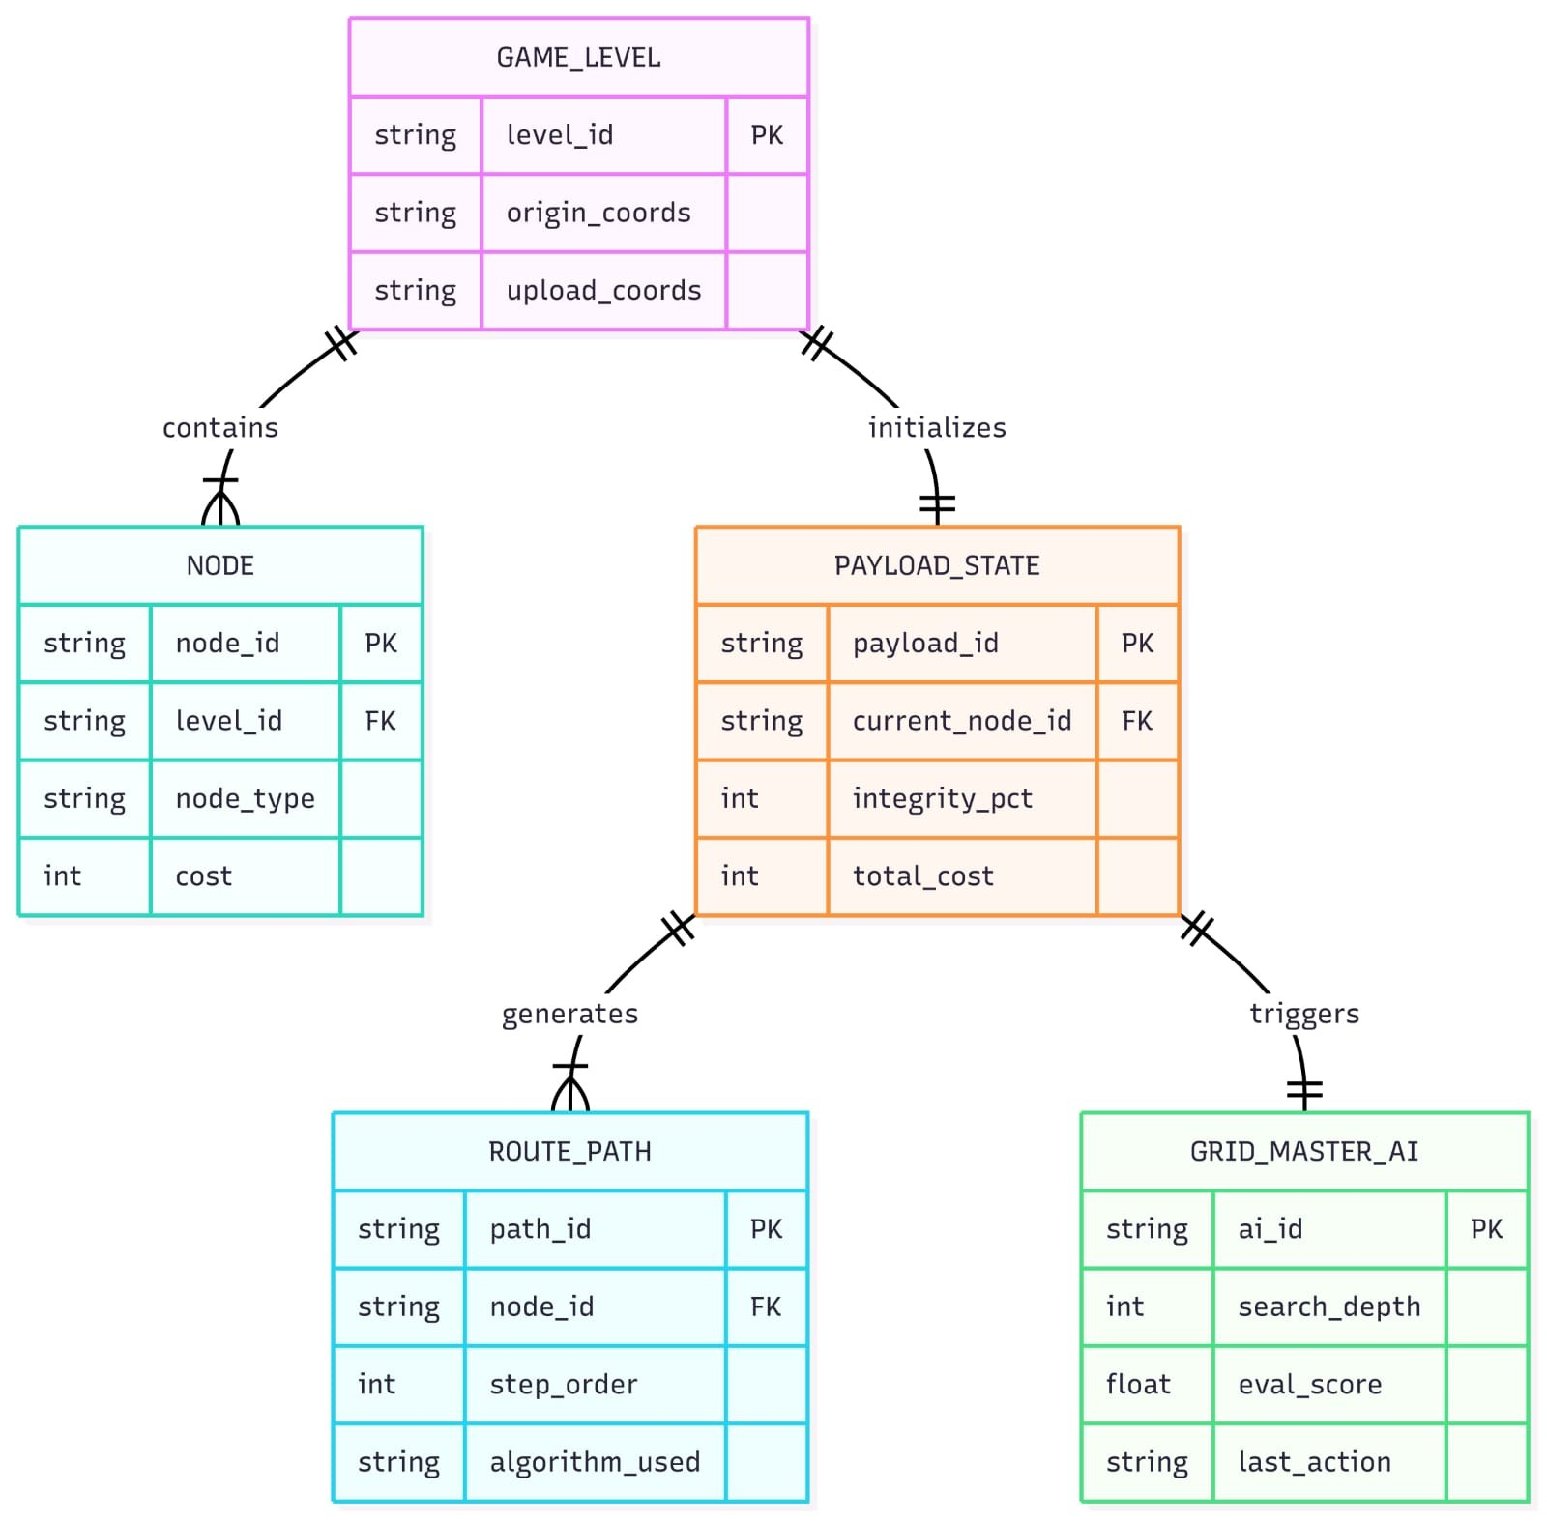
ER DIAGRAM

Slide 7
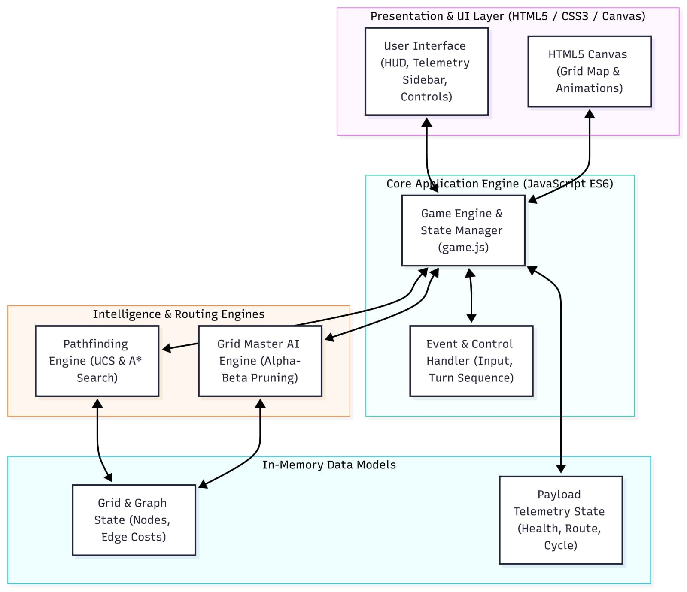
ARCHITECTURE DIAGRAM

Slide 8
THANK YOU

